Slide 1
Lipid Synthesis

Slide 2
Learning Objectives
Describe the conditions and tissues wherein fatty acids are generated, and from what precursors.
Explain the regulation of fatty acid biosynthesis by metabolite levels and hormones, including how it is ensured that beta-oxidation and de novolipogenesis do not occur simultaneously.
Understand the energy costs of generating fatty acids from glucose, compared with using glucose for fuel. Included in this is the source of carbon units, and reducing equivalents that are necessary for fatty acid biogenesis.
Analyze the role of citrate in co-ordination of glycolysis, TCA cycle activity and lipogenesis.
Explain the causes of lipodystrophy, including the metabolic consequences of ectopic fat deposition.
Understand how transcriptional and post-translational regulation control triglyceride synthesis and cholesterol synthesis.
Analyze the cellular conditions that lead to cholesterol synthesis and ketogenesis.
Describe the roles and activation of SREBP1 and SREBP2 in fatty acid/triglyceride and cholesterol biogenesis respectively.

Slide 3
Quiz Question #2
Which enzyme is not regulated by citrate levels?
Acetyl-CoA Carboxylase (ACC)
HMG-CoA Reductase (HMGCR)
Phosphofructokinase 1 (PFK1)
They are all regulated by citrate levels

Slide 4
Quiz Question #2
What is the rate limiting enzyme for de novo lipogenesis?
Acetyl-CoA Carboxylase
ATP-Citrate Lyase
Fatty Acid Synthase
HMG-CoA Reductase

Slide 5
Quiz Question #3
What macromolecule is the most energetically costly to synthesize in humans?
Palmitate (C16:0) from Glucose
Palmitoleate (C16:1) from Glucose
Alanine from Glucose
Lysine from Glucose

Slide 6
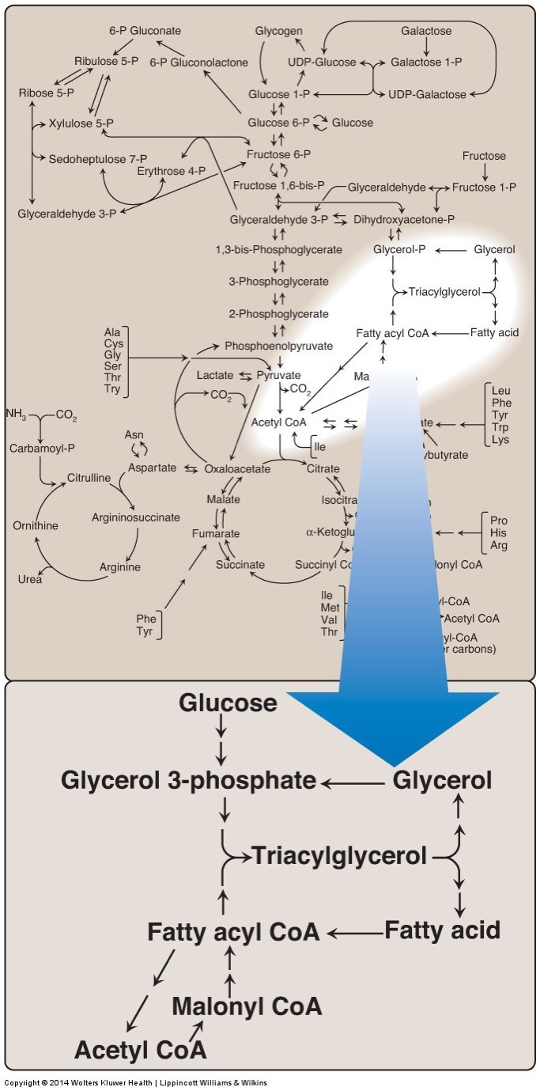
Synthesis of Fatty Acids
Two sources of fatty acids
Dietary
Synthesis from precursors (de novo)
Main sites of biosynthesis: liver and adipose tissue

Slide 7
Key Regulatory Steps
ATP Citrate Lyase
Acetyl CoA Carboxylase
Fatty Acid Synthase

Slide 8
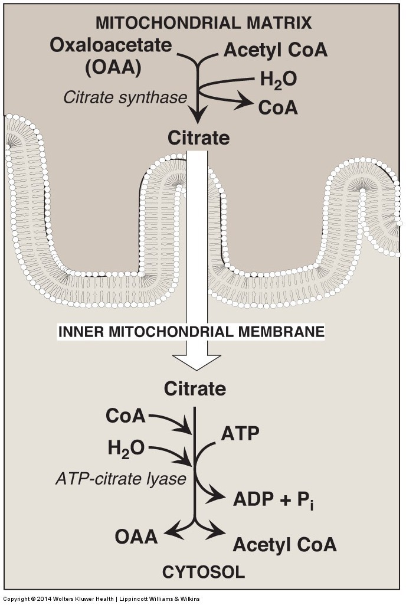
ATP – Citrate Lyase
The problem:
Acetyl CoA is needed for Fatty Acid Biosynthesis in the cytoplasm
Acetyl CoA from PDH/AA Catabolism is in the mitochondria
No AcetylCoA transporters
The solution
Citrate is made in mitochondria
Citrate is transported out, reconverted back to Acetyl CoA by ATP Citrate Lyase
Enzyme activated post-translationally by insulin and transcriptionally by SREBP and ChREBP

Slide 9
About the activity of ACLY
Insulin activates ATP-Citrate Lyase by phosphorylation. How would you characterize these effects?
Anaplerotic, reducing TCA cycle efficiency
Cataplerotic, reducing TCA cycle efficiency
Anaplerotic, increasing TCA cycle efficiency
Cataplerotic, increasing TCA cycle efficiency
Notes:
Answer is B

Slide 10
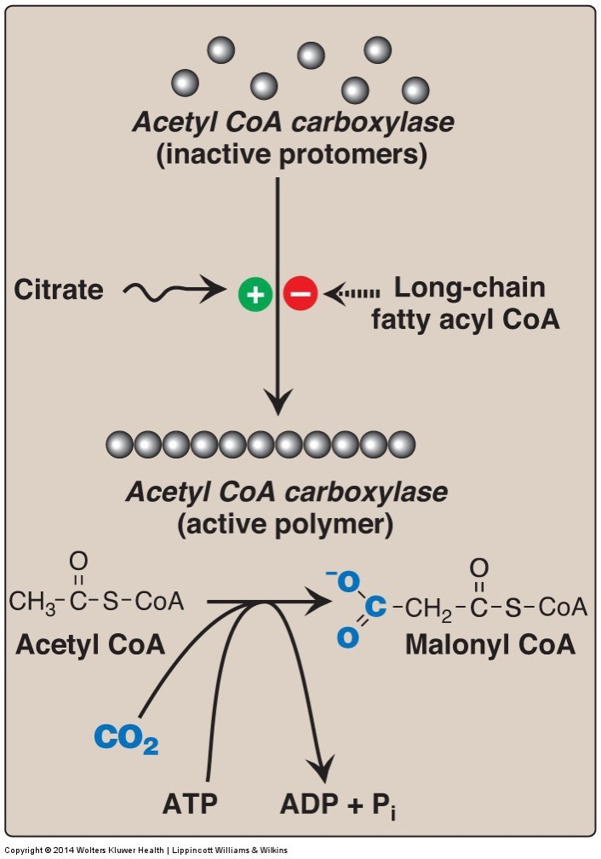
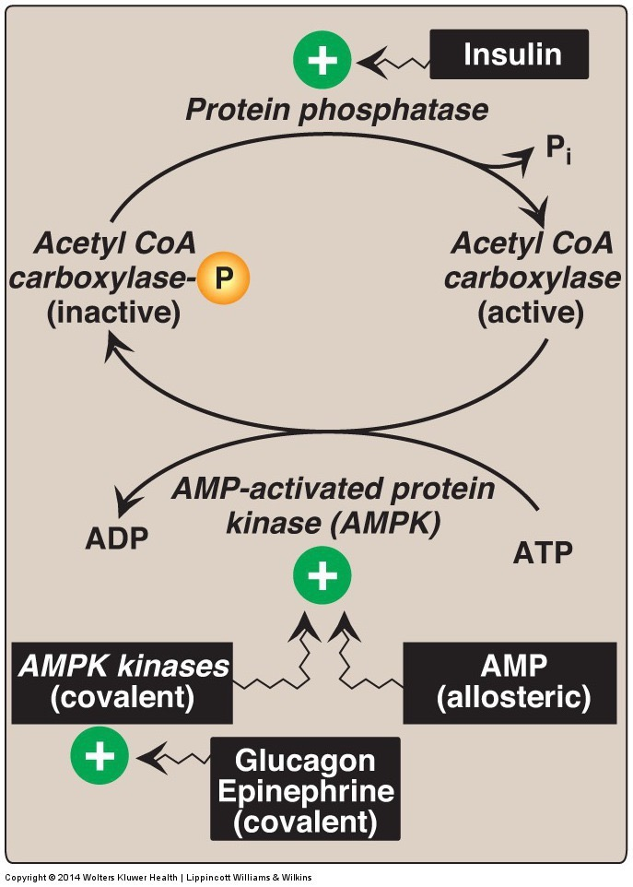
Acetyl CoA Carboxylase
Rate limiting enzyme for fatty acid biosynthesis
Regulated Allosterically
Inactivated by AMPK/PKA
Notes:
So low energy can prevent fatty acid synthesis

Slide 11
Citrate and Carbohydrate Metabolism
Sketch out how de novo lipogenesis and glycolysis are co-ordinated, importantly how and where does citrate affect glucose catabolism if ATP-Citrate Lyase is active.
Will this cause more or less Acetyl-CoA to be made from glucose?
Would this accelerate or decelerate de novo lipogenesis?
Are the same statements true for fructose?

Slide 12
Citrate and Carbohydrate Metabolism

Slide 13
Malonyl CoA Controls the Balance Between FA Synthesis and Degradation
Serves as a substrate for FA synthesis
Prevents re-import of fatty acids into mitochondria
CPT1 is a fatty acid transporter in mitochondria
Therefore Malonyl CoA prevents beta oxidation

Slide 14
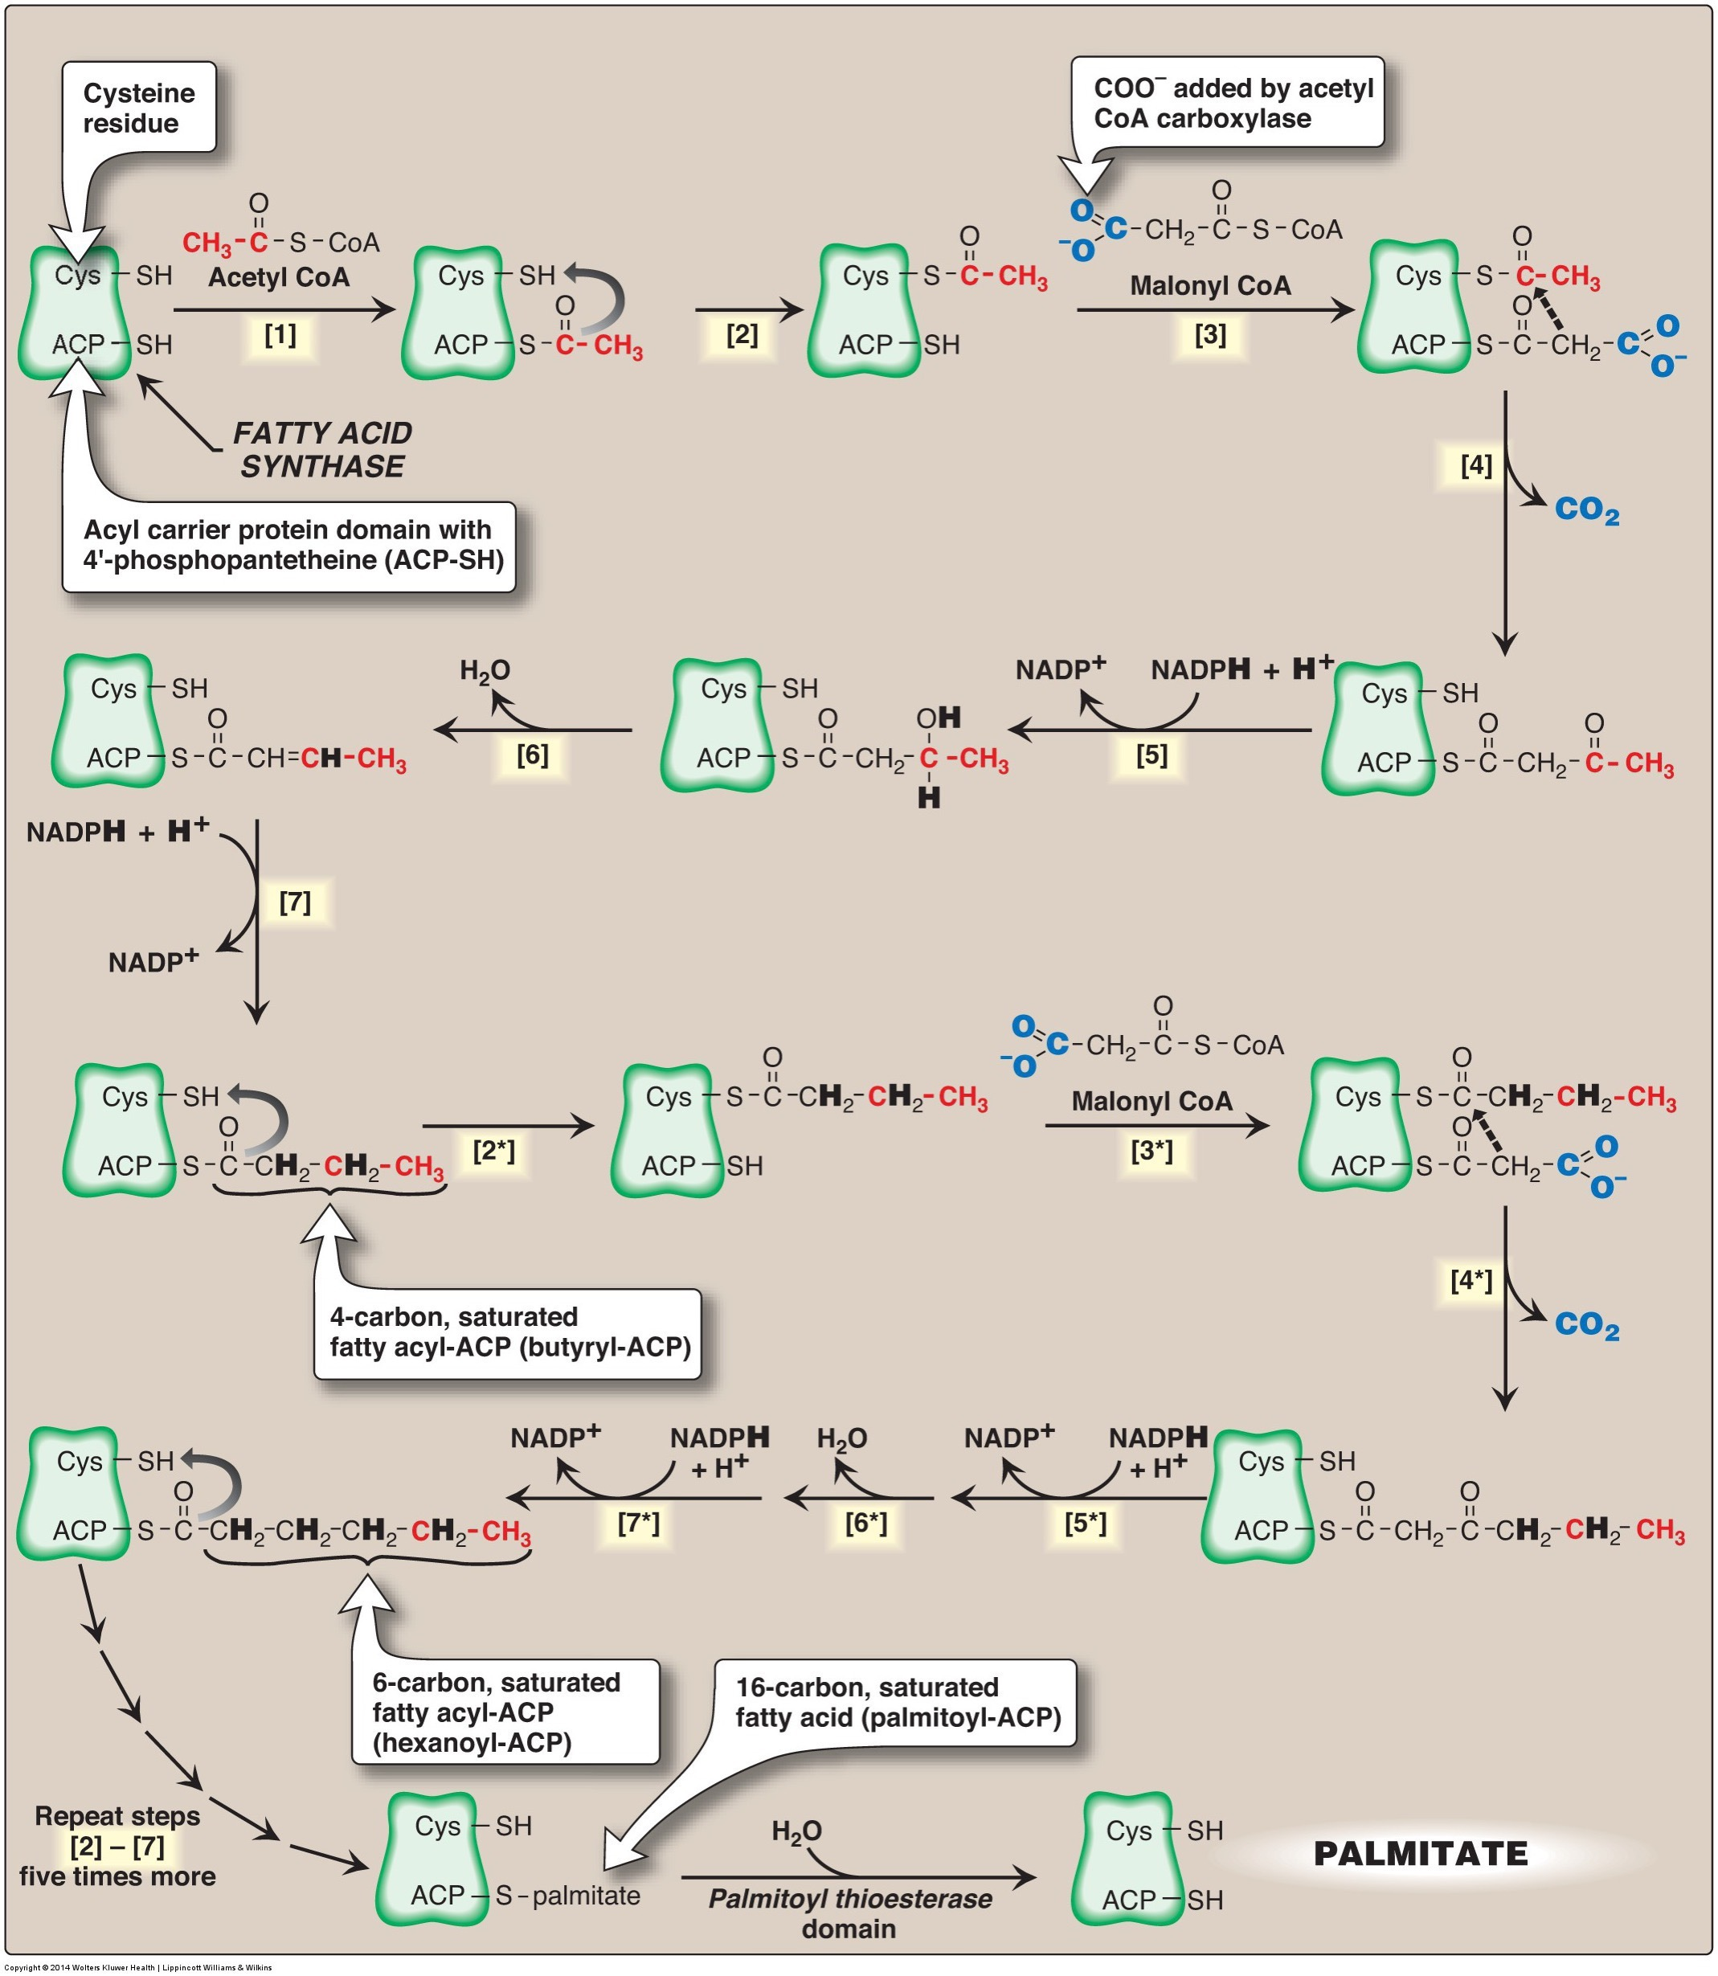
The Rest of Fatty Acid Synthesis is Mediated by Fatty Acid Synthase
Reaction including ACC:
Consumes:
8 Acetyl CoA (Primer then 7 Malonyl-Co from ACC)
7 ATP (to make Malonyl CoA from ACC)
14 NADPH
Makes 1 Palmitate (C16:0)
Additions are made 2 at a time
Very energy costly
Notes:
Plus some other waste products like CO2, ADP, NADP

Slide 15
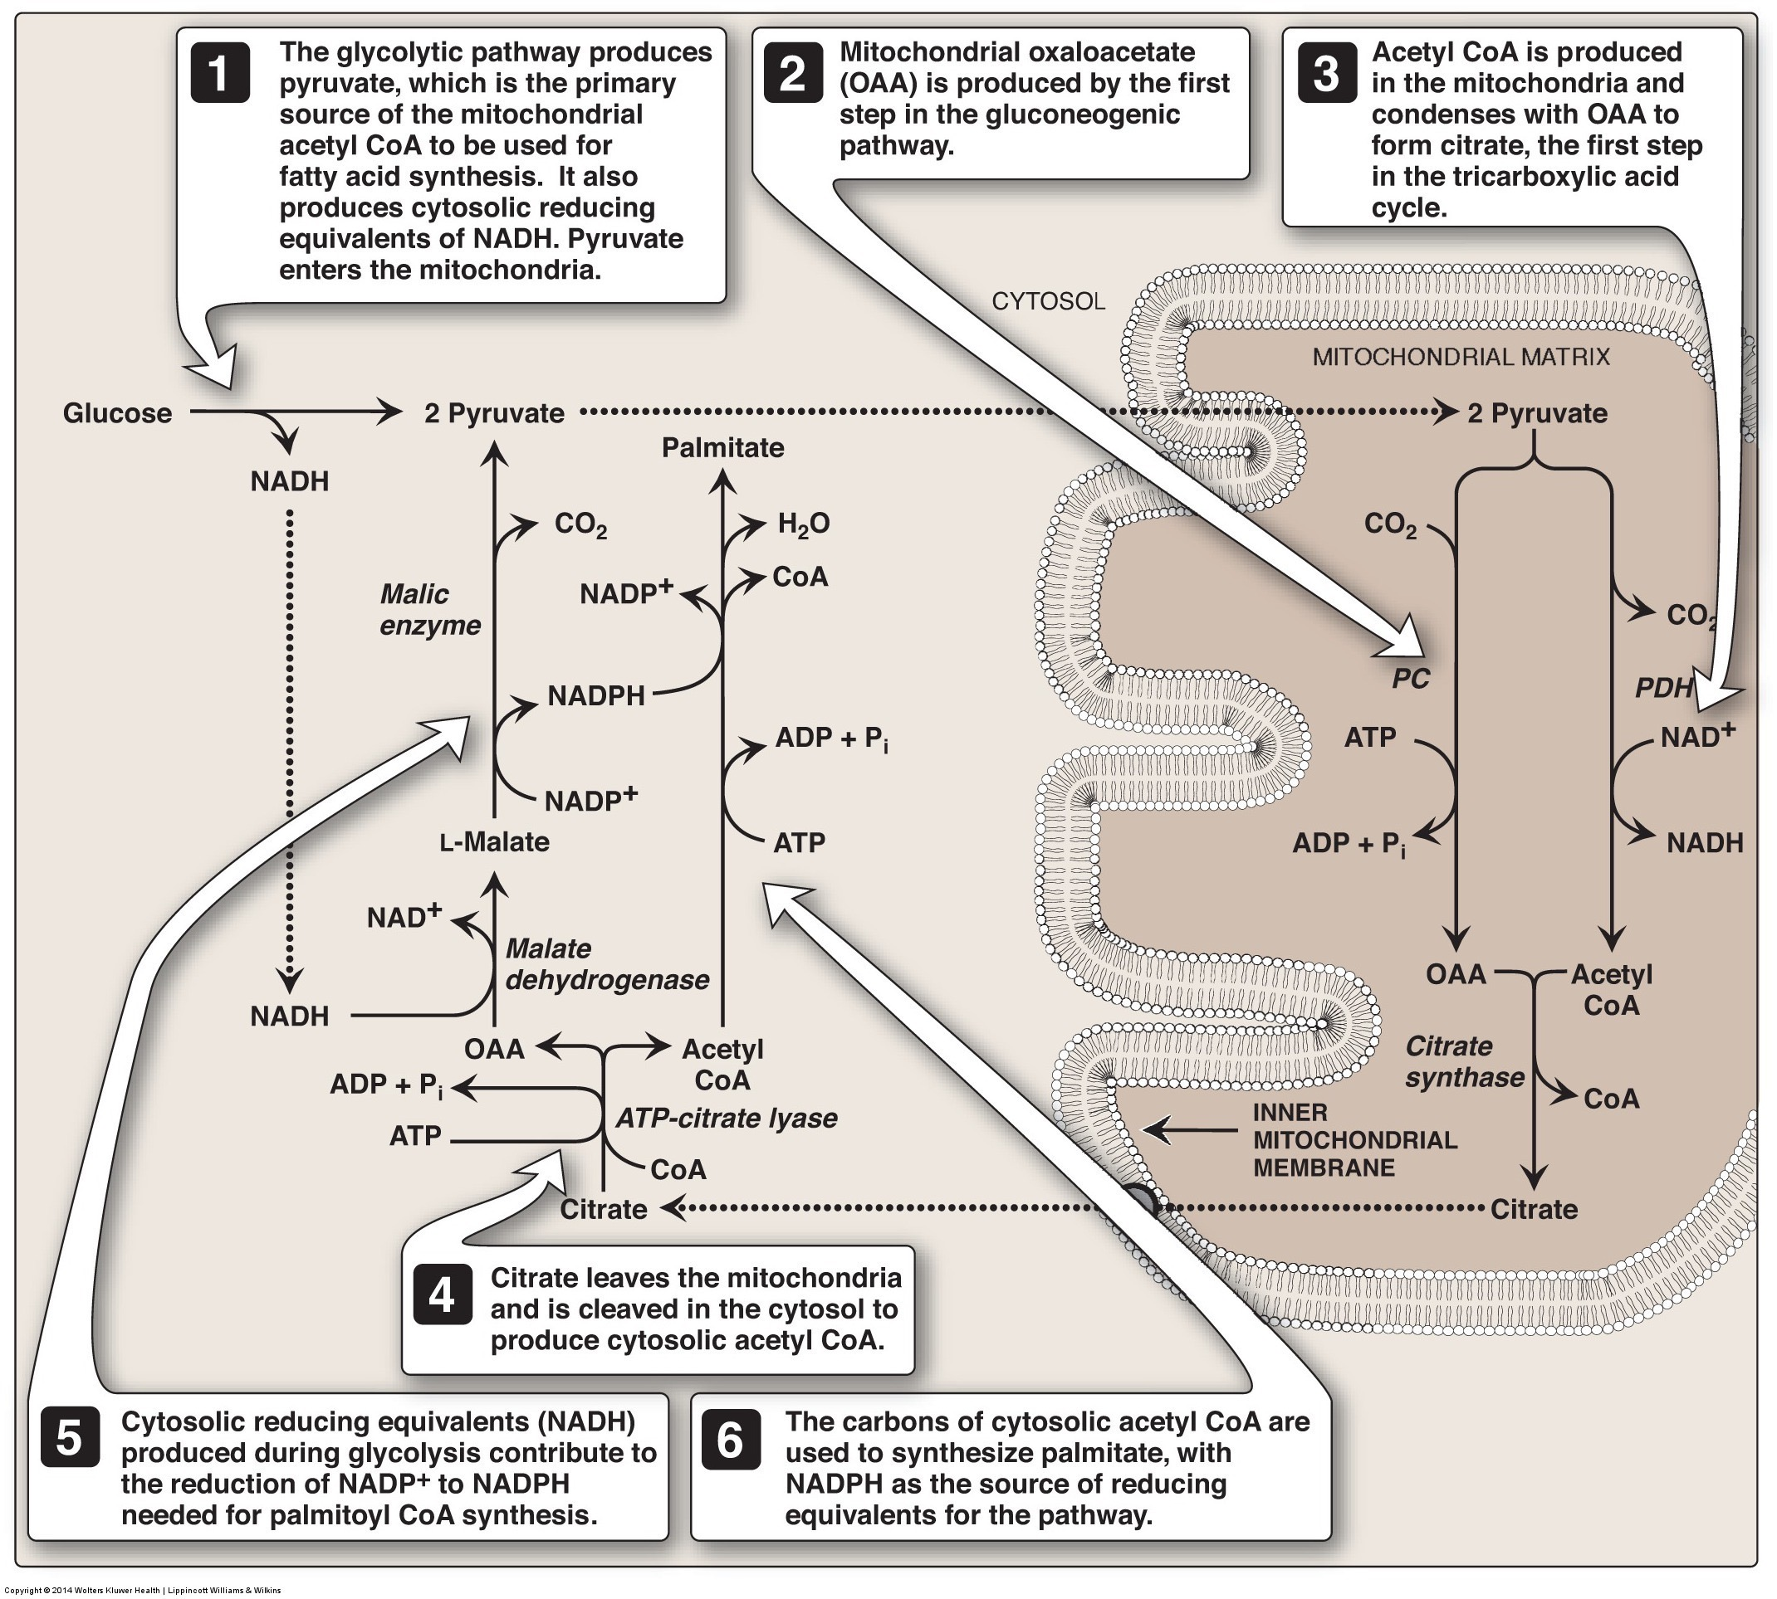
Two Sources of NADPH
First is Pentose Phosphate Pathway
Other ATP-Citrate Lyase Product is OAA
Converted to pyruvate generating one NADPH for each Acetyl-CoA

Slide 16
Transcriptional Control of FA Biosynthesis
ACC, ACLY and FAS are transactivated by
SREBP1c
Regulated by insulin/mTORC1
ChREBP
Regulated by high carbohydrates
GK – Glucokinase
PK – Pyruvate Kinase
EVOVL6 – Elongase
SCD1 – Desaturase (Δ9)
GPAT/DGAT – TG Synthesis

Slide 17
Regulation of SREBP1c
Saturated Fats
Insulin/mTORC1
PUFA

Slide 18
What happens to palmitate (C16:0)?
Further elongation (e.g. ELOVL6) and Desaturation (e.g. SCD1)
Humans have Δ9, Δ6, Δ5, Δ4 desaturases
VLC PUFAs are generated by sequential desaturation/elongation
But no n-3 or n-3 desaturase activity
Notes:
Competition between FA species
Elongations are by a factor of 2

Slide 19
Fatty Acid Exercise
Palmitate (C16)
Based on its length, what activity is closest to the methyl group (Δ9,6,5,4)
What ω-type of fatty acid is formed?
Repeat for stearate (C18)
What length fatty acid would we need to have to make a n-6 or n-3 MUFA, why is this unlikely endogenously?
Notes:
n-7, n-9

Slide 20
Triglyceride Synthesis

Slide 21
Triglyceride Esterification
Fatty Acyl-CoA
P
Fatty Acids
Dietary
From de novo lipogenesis
P
P
Lipin

Slide 22
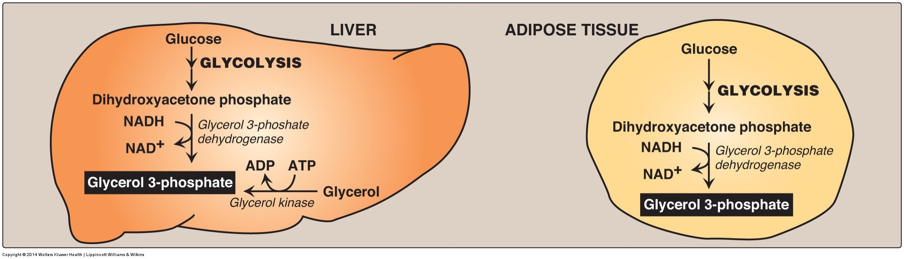
Glycerol for Triglyceride Synthesis
From glycolysis in liver and adipose
From glycerol only in liver
Major demand of glucose during lipid storage

Slide 23
Lipodystrophy and Insulin Resistance
If fat cannot be stored in adipocytes effectively it ends up in liver/muscle/blood vessels
Insulin resistance/diabetes if in the liver
Familial lipodystrophy genes include LMNA, Lipin, AGPAT2

Slide 24
Cholesterol Synthesis

Slide 25
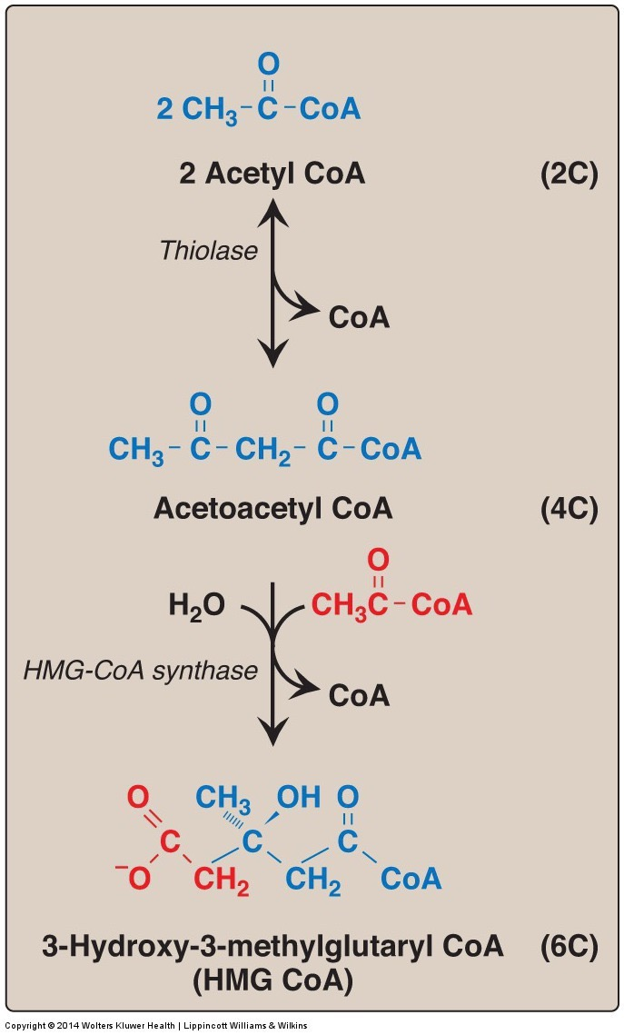
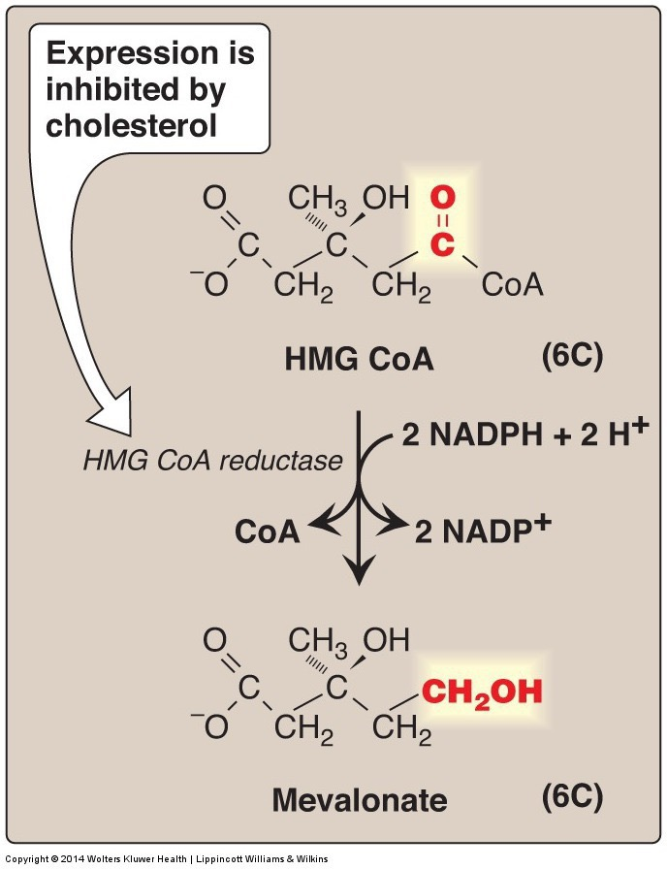
HMG-CoA Reductase

Slide 26
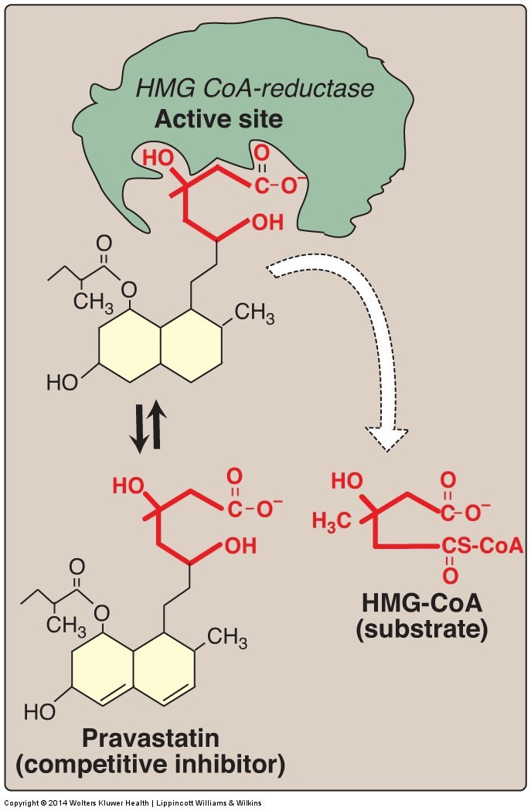
HMGCR is the Target of Statins

Slide 27
Cholesterol Biosynthesis Regulation
Negative feedback on HMG CoA reductase
Dietary intake of cholesterol suppresses production only in liver
Specific sterol responsible for feedback unclear but is most likely a 25-oxysterol
Song BL, Javitt NB, DeBose-Boyd RA. Insig-mediated degradation of HMG CoA reductase stimulated by lanosterol, an intermediate in the synthesis of cholesterol. Cell Metab. 2005; 1: 179–89. doi: 10.1016/j.cmet.2005.01.001.

Slide 28
Transcriptional Regulation of Cholesterol Biogenesis
SREBP2 activation is inhibited by sterols
Targets of SREBP2 reduced when sterols are high:
HMG-CoA Reductase
HMG-CoA Synthase
LDL Receptor

Slide 29
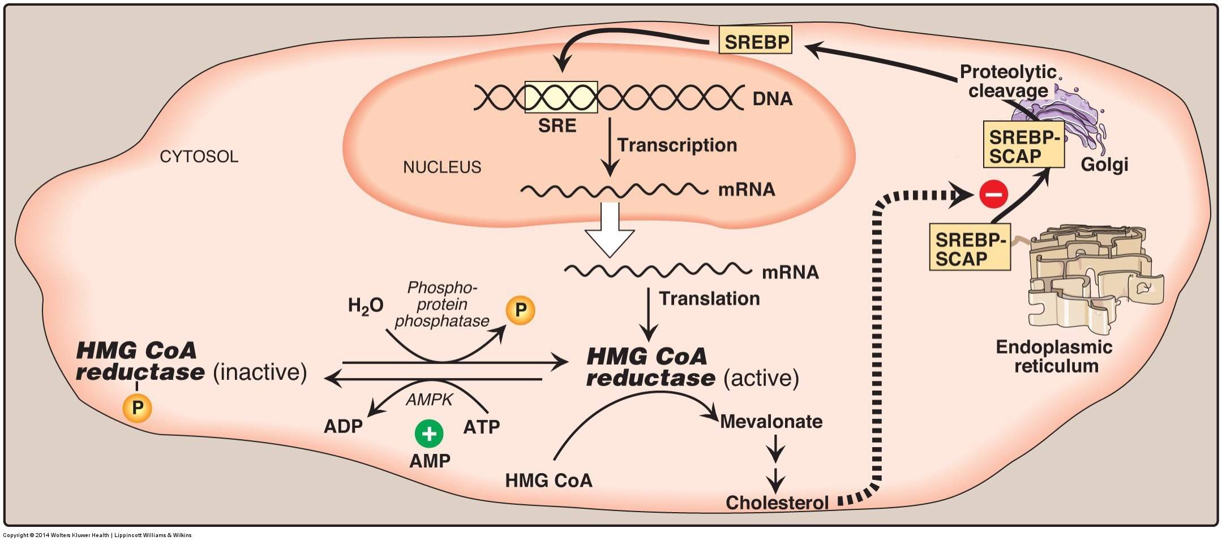
AMPK Regulates Cholesterol Synthesis
AMPK Prevents both cholesterol (HMGCR) and fatty acid synthesis (ACC) when there is energy demand

Slide 30
Ketogenesis
What happens when Acetyl-CoA production exceeds demand?

Slide 31
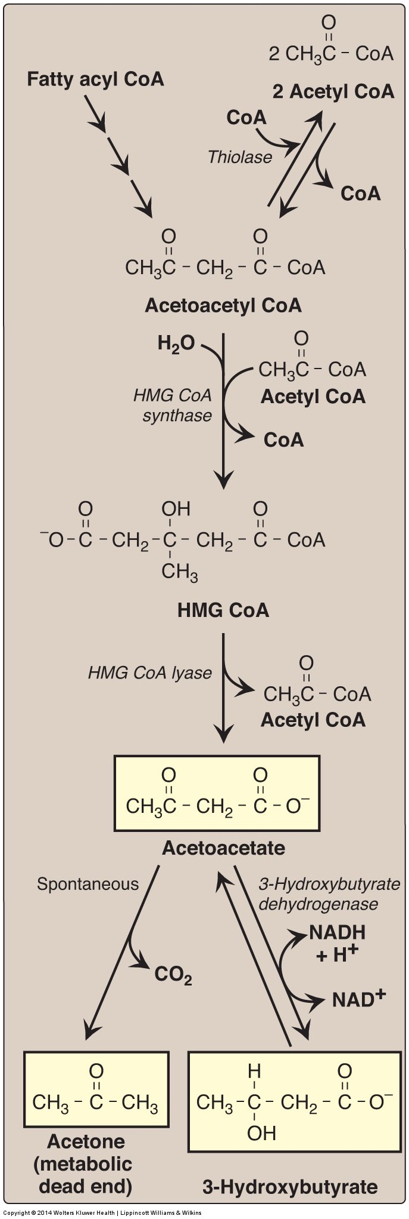
Ketogenesis
Ketogenesis produces ketone bodies
Acetone
Acetoacetate
Beta-hydroxybutyrate
First steps same as cholesterol
Transported to other tissues to be oxidized (converted back to Acetyl-CoA)

Slide 32
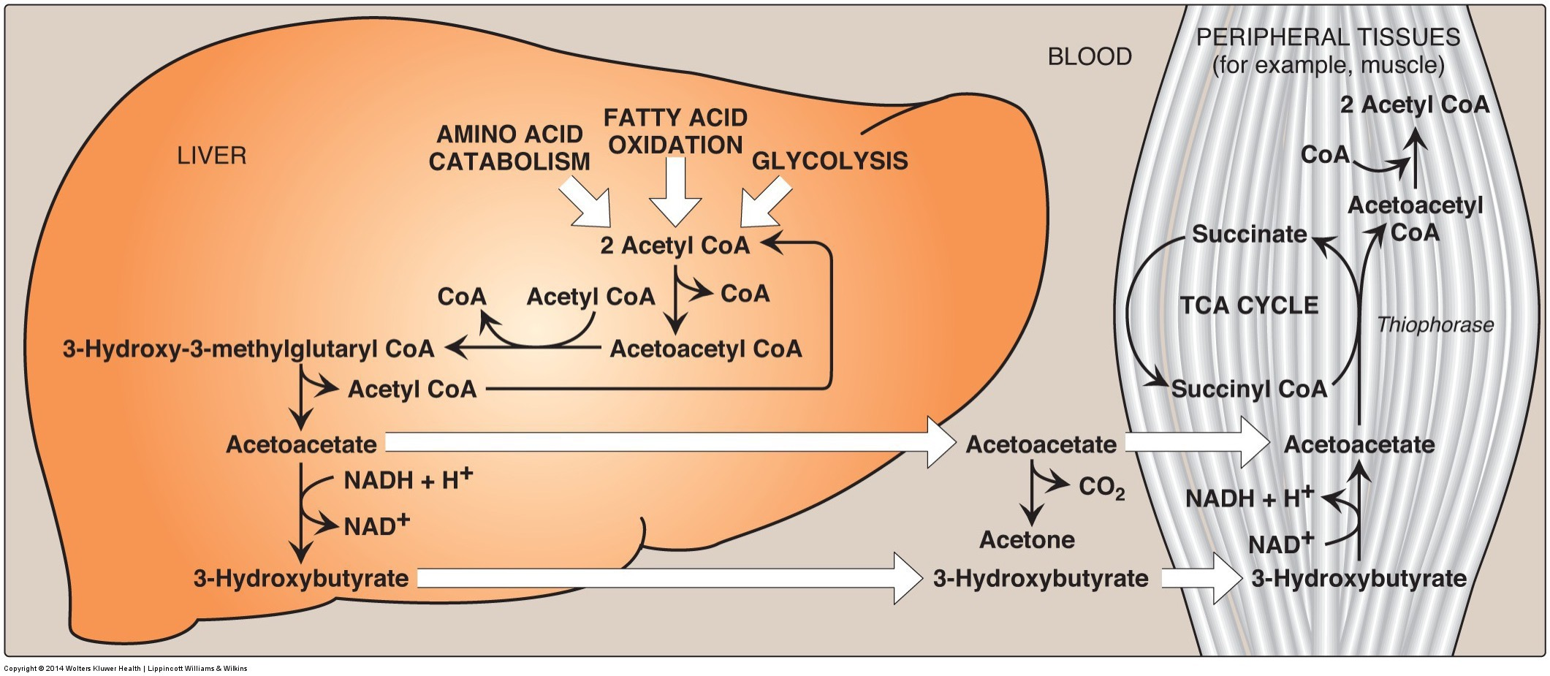
Ketone Bodies
Ketogenesis:
Mainly occurs in liver
Ketones do not stay in liver because it lacks enzyme for initial reaction of ketone body oxidation
Ketone body oxidation: ketone bodies → Acetyl CoA
Brain, heart, muscle, etc.
Acetyl CoA enters TCA cycle

Slide 33
Diabetic Ketoacidosis
Causes
Consequences
Conditions in which build up could occur
Untreated type 1 and type 2 diabetes: Low levels of circulating insulin
Type 1 – beta cells cannot make insulin
Type 2 – beta cells are damaged from prolonged periods of overproduction of insulin
Cannot stop lipolysis, excess Acetyl-CoA in the liver
Accompanied by hyperglycemia
Coma,
Dehydration
excessive urination
vomiting
organ failure
About 140 000 hospitalizations per year in the USA (CDC, 2009)

Slide 34
Ketogenic Diets
Very low carbohydrate diets
Accompanied by normoglycemia
DKA: beta hydroxybutyrate >15 mM
Nutritional Ketosis: beta hydroxybutyrate <3 mM
Notes:
Think in the muscle, what is controlling the levels of OAA

Slide 35
Learning Objectives
Describe the conditions and tissues wherein fatty acids are generated, and from what precursors.
Explain the regulation of fatty acid biosynthesis by metabolite levels and hormones, including how it is ensured that beta-oxidation and de novolipogenesis do not occur simultaneously.
Understand the energy costs of generating fatty acids from glucose, compared with using glucose for fuel. Included in this is the source of carbon units, and reducing equivalents that are necessary for fatty acid biogenesis.
Analyze the role of citrate in co-ordination of glycolysis, TCA cycle activity and lipogenesis.
Explain the causes of lipodystrophy, including the metabolic consequences of ectopic fat deposition.
Understand how transcriptional and post-translational regulation control triglyceride synthesis and cholesterol synthesis.
Analyze the cellular conditions that lead to cholesterol synthesis and ketogenesis.
Describe the roles and activation of SREBP1 and SREBP2 in fatty acid/triglyceride and cholesterol biogenesis respectively.

